Slide 1
Towards a Smart City with Smart Traffic Lights
By: Selina Dersarkissian

Slide 2
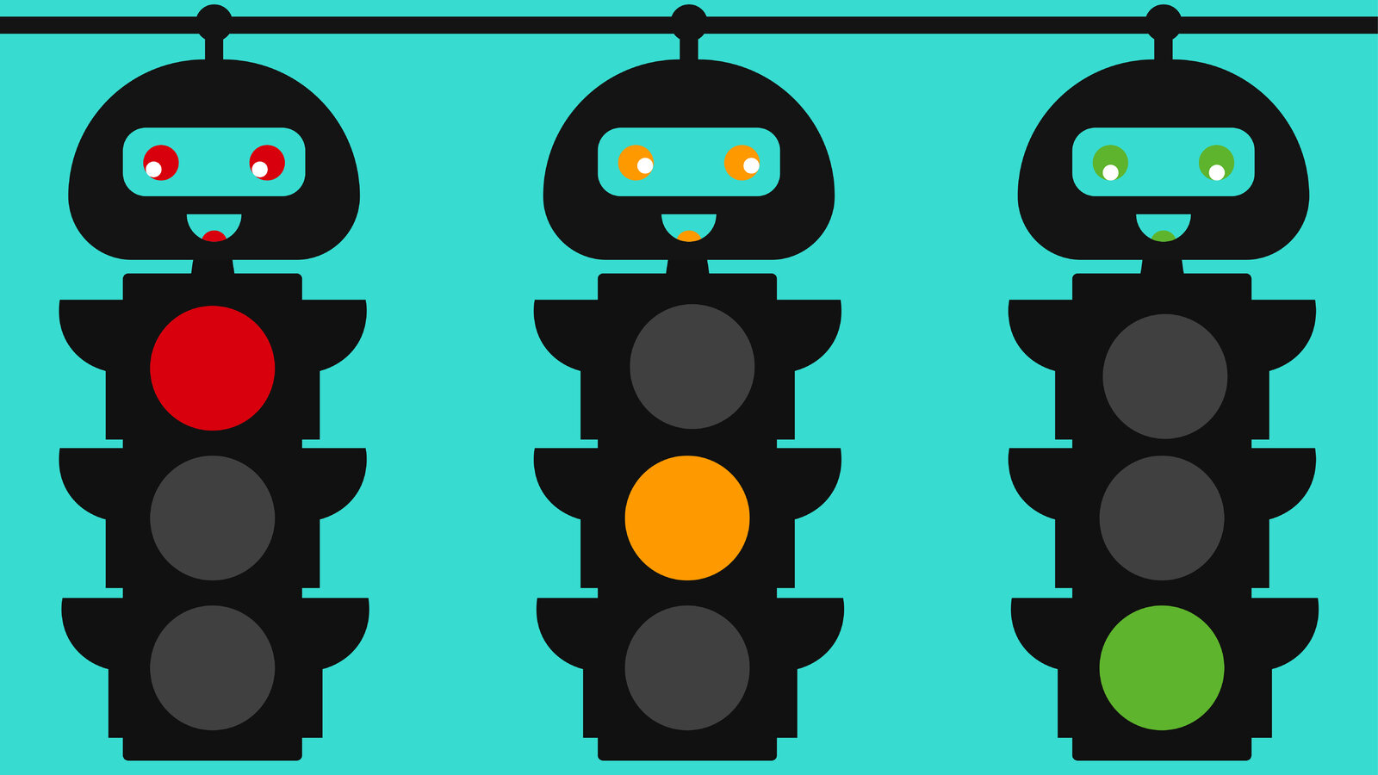
INTRODUCTION
Imagine that there are over two million vehicles on the road in Jordan!
Knowing that our roads are generally narrow with this huge amount of cars, it already tell us of how crowded traffic jams are.
This becomes one of the biggest issues in Jordan faced on a daily basis.
Consequently, I decided to dedicate my project to lessen the chance of traffic at car districts.
Instead of traffic lights to be controlled based on set time, my project is a smart traffic light that
works according to car density rather than time to reduce traffic.

Slide 3
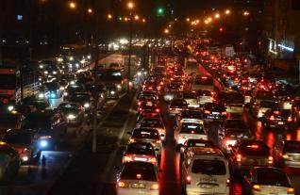
BACKGROUND AND LITERATURE REVIEW
Car traffic is a major issue in Jordan, that is faced on a day to day basis.
There is concern about the number of vehicles on roads as estimated to over two million and 100 thousand vehicles.
Delays caused by traffic congestion in Amman cost an estimate of JD1.5 billion annually; of which fuel and time wasted.

Slide 4
PROCESS FOR THE PROJECT
Brainstorming ideas
Planning the project
Sketching the design
Preparing the code
Building the prototype
Preparing the poster
Day of presenting

Slide 5
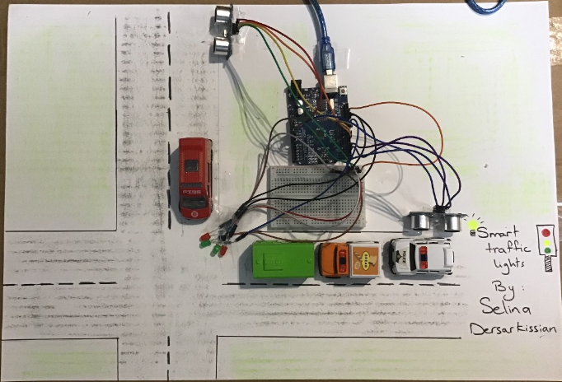
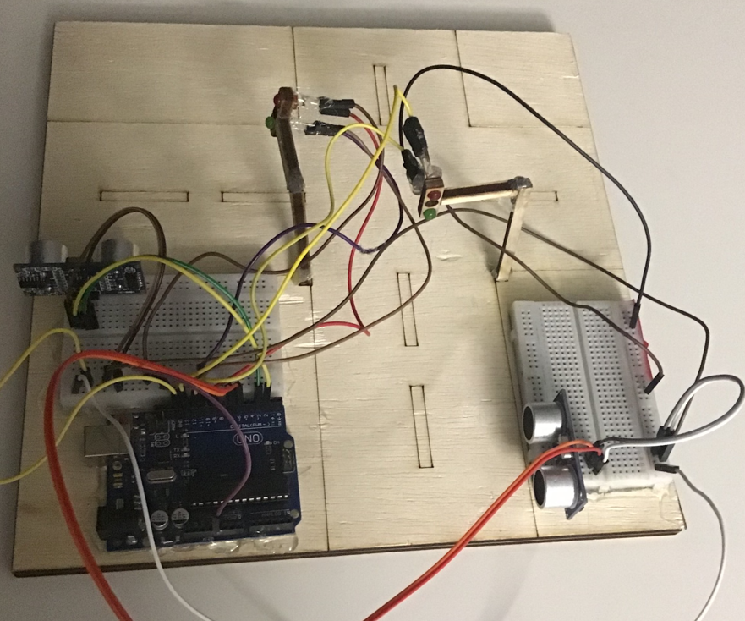
SOLUTION
My smart traffic light works according to density of the cars.
Detects the capacity of cars
Sends information to the microcontroller (Arduino UNO)
Compares the capacities
The district with more cars has the priority for the green light.

Slide 6
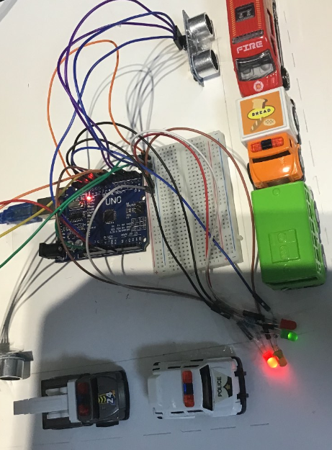
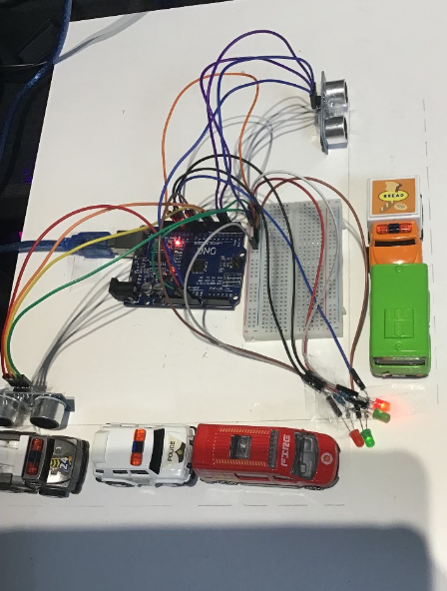
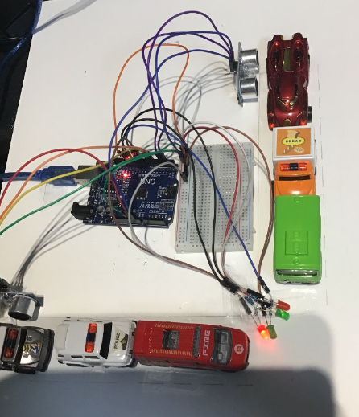
DATA ANALYSIS AND RESULTS
2.93
District 1> District 2
District 1< District 2
District 1= District 2
District one has a priority and the green light flashes.
District two has a priority and the green light flashes.
The traffic light works alternatively.

Slide 7

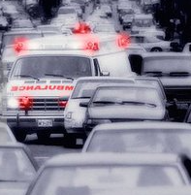
CONCLUSIONS AND FUTURE WORKS
Conclusion
In conclusion, to eliminate the long ques in traffic jams, for example on districts; my smart traffic light works on car density on the road rather than set time. Using its ultrasonic sensor it is able to measure which district has more capacity of cars and allow the more crowded one to have priority in moving.
Future works
In the future, to further elaborate on my idea of smart traffic lights and to contribute in solving car traffic issues; a great addition to the project would be adding a sensor on traffic lights that detects waves of signals with those signals attatched on ambulance cars in order to turn green and give priority for the ambulance to pass in order to ensure that the patient reaches the hospital on time without delays.

Slide 8
THANK YOU FOR
YOUR TIME

